Slide 1
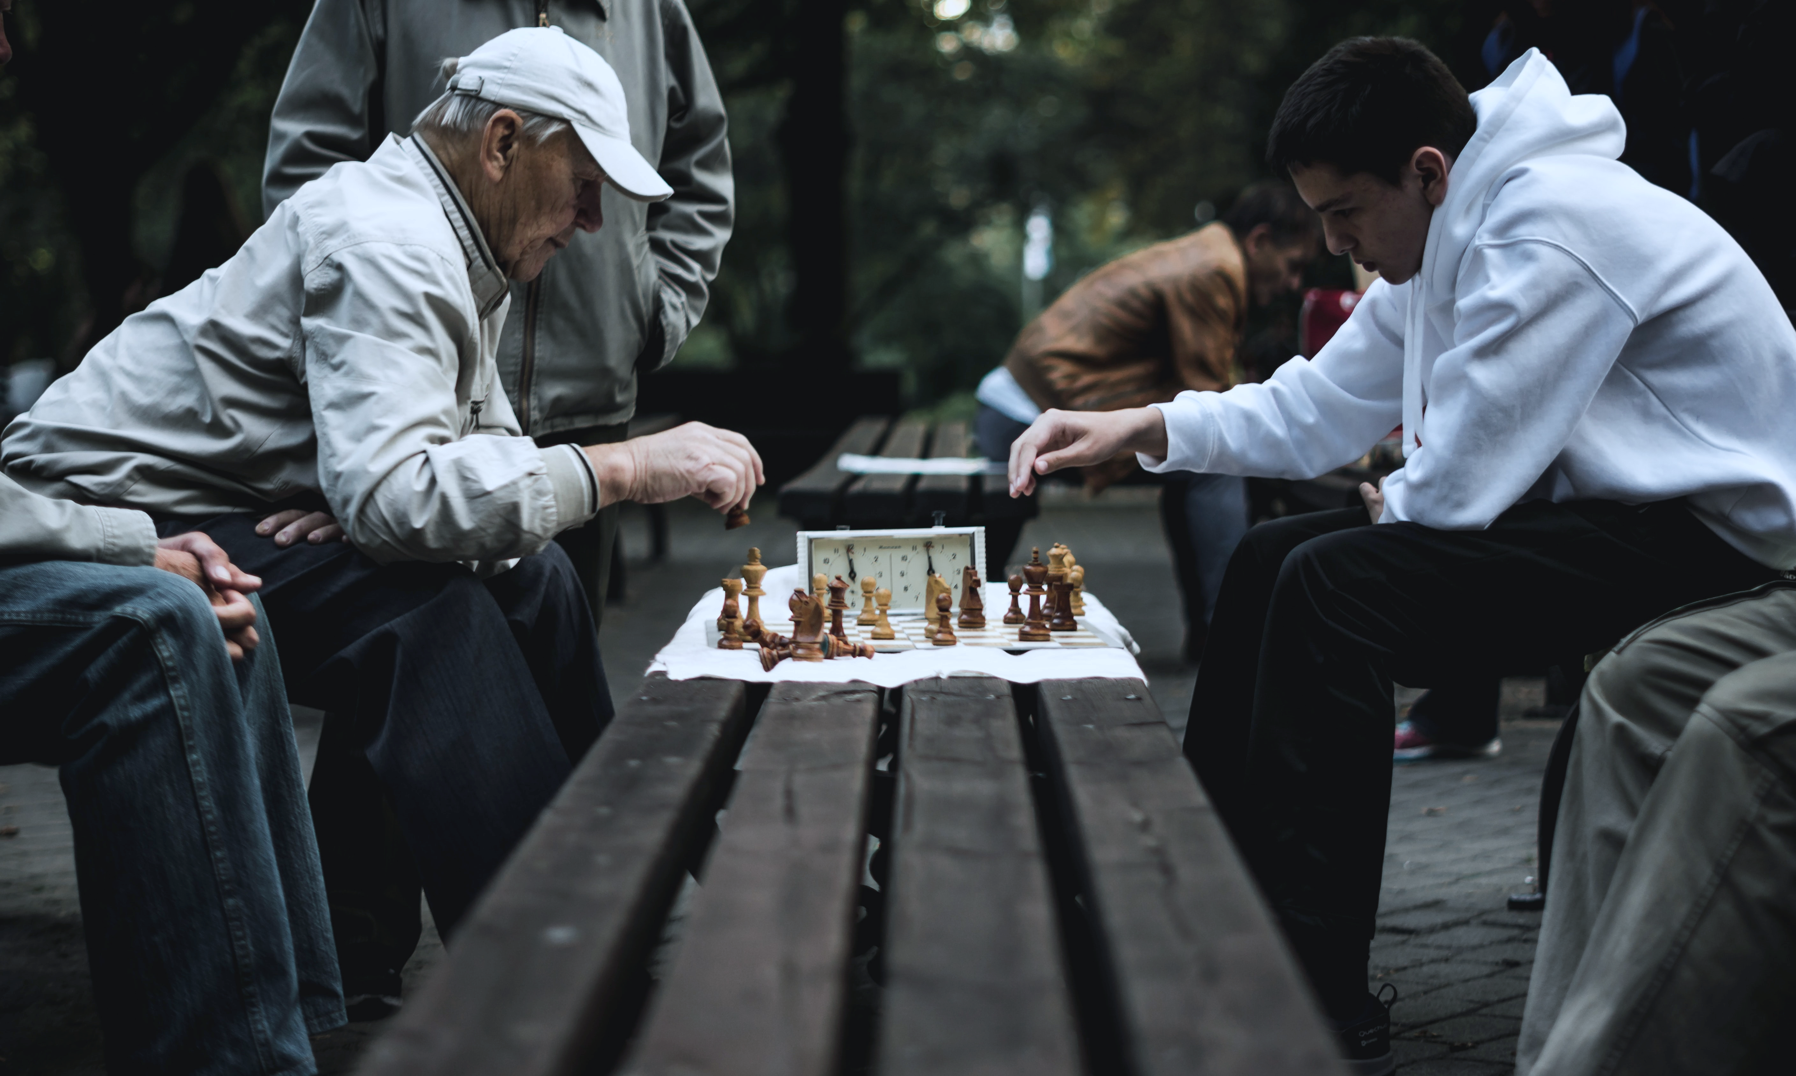
From Semantic Games to Analytic Calculi
📷 Tanner Mardis
Robert Freiman

Slide 2
Semantic Game (truth in a model)
lift
Provability Game
(validity)
extract
Analytic Calculus
Notes:
Unkonventionelle Struktur explizit
Let me start unconventionally, later talk about overview

Slide 3

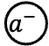
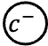
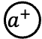
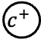
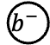
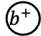
Hintikka‘s Semantic Game
$$a^{+}$$
$$b^{+}$$
$$c^{+}$$
$$⋮$$
$$a^{−}$$
$$b^{−}$$
$$c^{−}$$

Slide 4


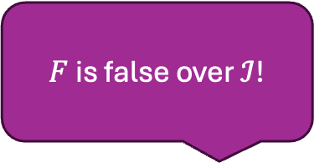


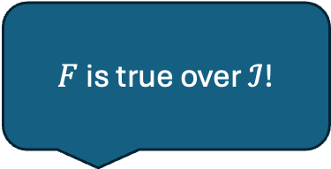

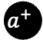
Hintikka‘s Semantic Game
Formula $F=\left[a^{−}∨\left(b^{+}∧c^{−}\right)\right]∨\left[a^{+}∧b^{−}\right]$
Model $ℐ=\left\{a^{+},b^{−},c^{−}\right\}$
$$a^{+}$$
$$b^{+}$$
$$c^{+}$$
$$⋮$$
$$a^{−}$$
$$b^{−}$$
$$c^{−}$$
$F$ is true over $ℐ$!
$F$ is false over $ℐ$!
Proponent
Opponent
Notes:
Negation durch Role Switch erwähnen, aber nicht betrachtet (verbal)

Slide 5
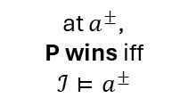
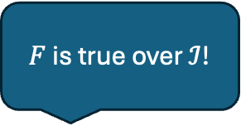



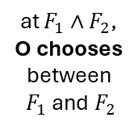
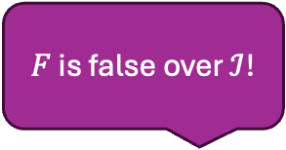
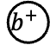
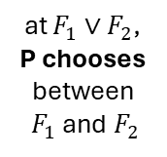
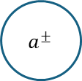
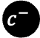
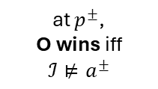
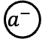

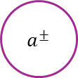
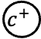
Hintikka‘s Semantic Game
$$a^{+}$$
$$b^{+}$$
$$c^{+}$$
$$a^{−}$$
$$b^{−}$$
$$c^{−}$$
Formula $F=\left[a^{−}∨\left(b^{+}∧c^{−}\right)\right]∨\left[a^{+}∧b^{−}\right]$
Model $ℐ=\left\{a^{+},b^{−},c^{−}\right\}$
$∨$
$∧$
$a^{±}$
$a^{±}$
at $F_{1}∨F_{2}$, P chooses between $F_{1}$ and $F_{2}$
at $F_{1}∧F_{2}$, O chooses between $F_{1}$ and $F_{2}$
at $a^{±}$,
P wins iff $ℐ⊨a^{±}$
at $p^{±}$,
O wins iff $ℐ⊭a^{±}$
$F$ is true over $ℐ$!
$F$ is false over $ℐ$!
Notes:
Formel animation löschen

Slide 6
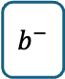
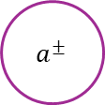

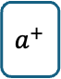
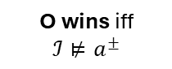
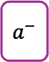
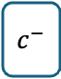


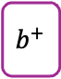
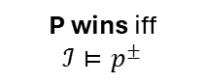
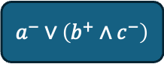
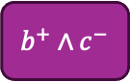

Example
$$a^{+}$$
$$b^{+}$$
$$c^{+}$$
$$a^{−}$$
$$b^{−}$$
$$c^{−}$$
Formula $F=\left[a^{−}∨\left(b^{+}∧c^{−}\right)\right]∨\left[a^{+}∧b^{−}\right]$
Model $ℐ=\left\{a^{+},b^{−},c^{−}\right\}$
$∨$
$\left[a^{−}∨\left(b^{+}∧c^{−}\right)\right]∨\left[a^{+}∧b^{−}\right]$
P chooses
$∧$
$a^{−}∨\left(b^{+}∧c^{−}\right)$
$a^{+}∧b^{−}$
O chooses
$a^{±}$
$a^{−}$
$b^{+}∧c^{−}$
$a^{+}$
$b^{−}$
P wins iff $ℐ⊨p^{±}$
$a^{±}$
$b^{+}$
$c^{−}$
O wins iff $ℐ⊭a^{±}$
Notes:
animation formel löschen (auch nächste Slides?)

Slide 7
Example
$$a^{+}$$
$$b^{+}$$
$$c^{+}$$
$$a^{−}$$
$$b^{−}$$
$$c^{−}$$
Formula $F=\left[a^{−}∨\left(b^{+}∧c^{−}\right)\right]∨\left[a^{+}∧\left(b^{−}∨c^{+}\right)\right]$
Model $ℐ=\left\{a^{+},b^{−},c^{−}\right\}$
P has a winning strategy:
$∨$
$\left[a^{−}∨\left(b^{+}∧c^{−}\right)\right]∨\left[a^{+}∧b^{−}\right]$
P chooses
$∧$
$a^{−}∨\left(b^{+}∧c^{−}\right)$
$a^{+}∧b^{−}$
O chooses
$a^{±}$
$a^{−}$
$b^{+}∧c^{−}$
$a^{+}$
$b^{−}$
P wins iff $ℐ⊨p^{±}$
$a^{±}$
$b^{+}$
$c^{−}$
O wins iff $ℐ⊭a^{±}$
Notes:
falsche Formel
dicke Striche

Slide 8
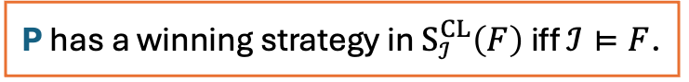
Example
$$a^{+}$$
$$b^{+}$$
$$c^{+}$$
$$a^{−}$$
$$b^{−}$$
$$c^{−}$$
Formula $F=\left[a^{−}∨\left(b^{+}∧c^{−}\right)\right]∨\left[a^{+}∧\left(b^{−}∨c^{+}\right)\right]$
Model $ℐ=\left\{a^{+},b^{−},c^{−}\right\}$
P has a winning strategy:
$∨$
$\left[a^{−}∨\left(b^{+}∧c^{−}\right)\right]∨\left[a^{+}∧b^{−}\right]$
P chooses
$∧$
$a^{+}∧b^{−}$
O chooses
$a^{±}$
$a^{+}$
$b^{−}$
P wins iff $ℐ⊨p^{±}$
$a^{±}$
O wins iff $ℐ⊭a^{±}$
P has a winning strategy in $S_{ℐ}^{CL}\left(F\right)$ iff $ℐ⊨F$.
Notes:
Two times theorem box?

Slide 9
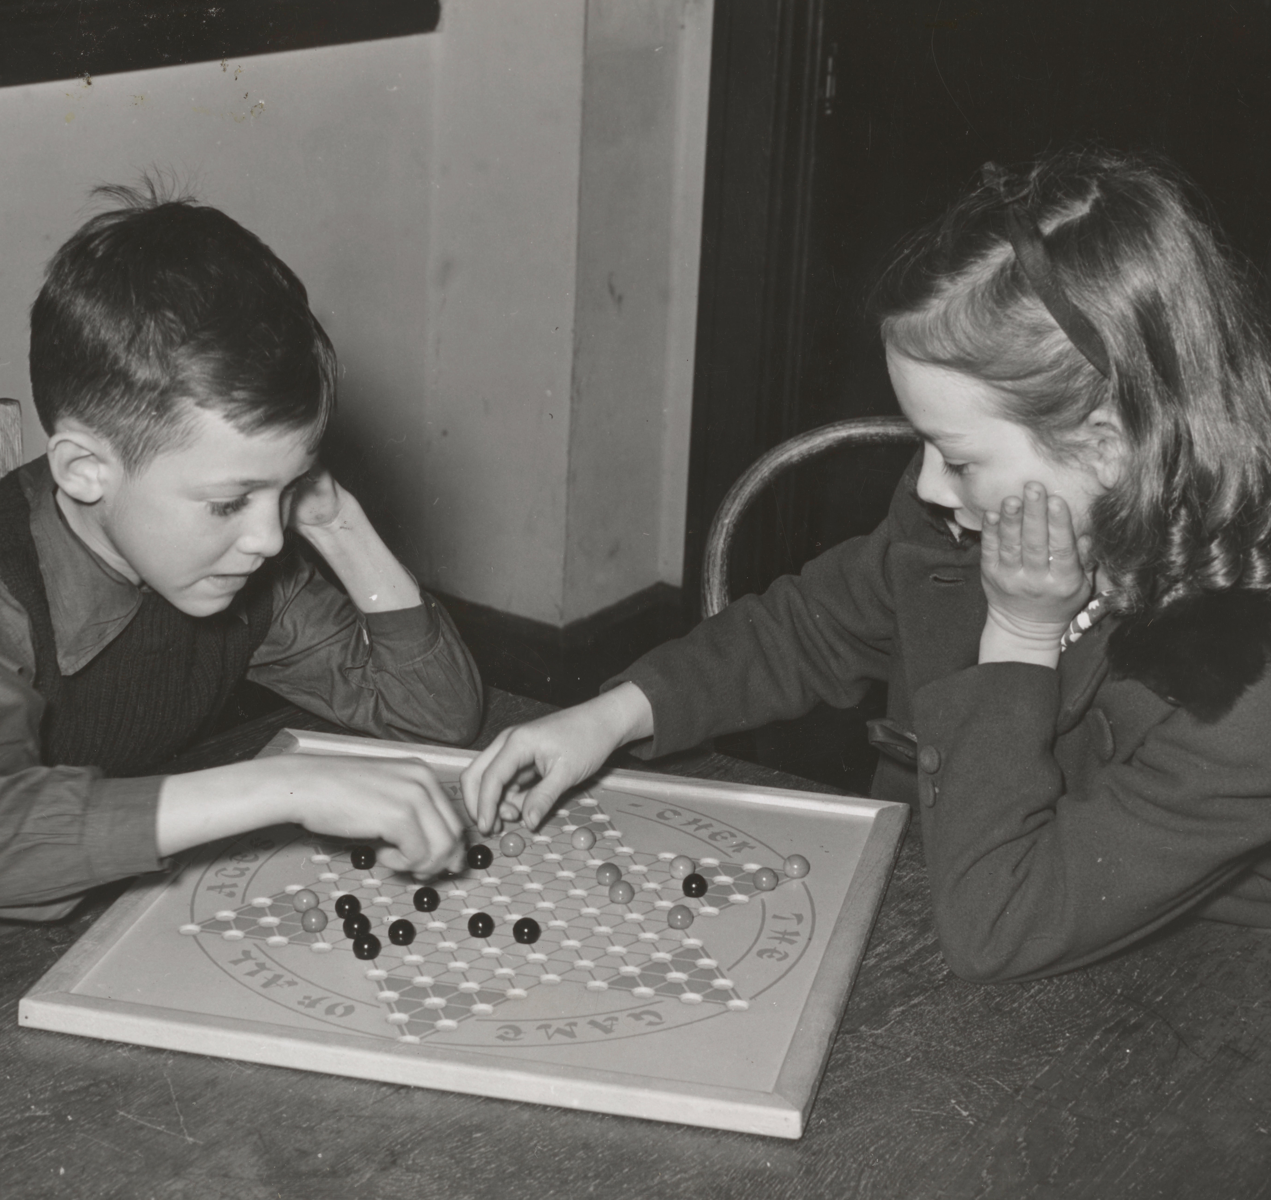
From Semantic Games to Provability Games
Can P play the game such that she wins in every model?
📷The New York Public Library
Notes:
Selbe Font in der Überschrift

Slide 10

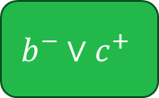
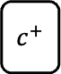
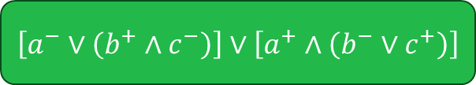


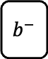
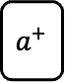
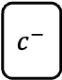


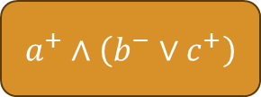
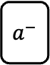
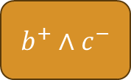
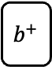
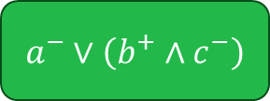

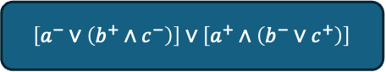
Uniform Strategies?
Can P play the game such that she wins in every model?
$\left[a^{−}∨\left(b^{+}∧c^{−}\right)\right]∨\left[a^{+}∧\left(b^{−}∨c^{+}\right)\right]$
$\left[a^{−}∨\left(b^{+}∧c^{−}\right)\right]∨\left[a^{+}∧\left(b^{−}∨c^{+}\right)\right]$
$\left[a^{−}∨\left(b^{+}∧c^{−}\right)\right]∨\left[a^{+}∧\left(b^{−}∨c^{+}\right)\right]$
$\left[a^{−}∨\left(b^{+}∧c^{−}\right)\right]∨\left[a^{+}∧\left(b^{−}∨c^{+}\right)\right]$
$\left[a^{−}∨\left(b^{+}∧c^{−}\right)\right]∨\left[a^{+}∧\left(b^{−}∨c^{+}\right)\right]$
$a^{−}∨\left(b^{+}∧c^{−}\right)$
$a^{−}∨\left(b^{+}∧c^{−}\right)$
$a^{−}∨\left(b^{+}∧c^{−}\right)$
$a^{−}∨\left(b^{+}∧c^{−}\right)$
$a^{−}∨\left(b^{+}∧c^{−}\right)$
$a^{+}∧\left(b^{−}∨c^{+}\right)$
$a^{+}∧\left(b^{−}∨c^{+}\right)$
$a^{+}∧\left(b^{−}∨c^{+}\right)$
$a^{+}∧\left(b^{−}∨c^{+}\right)$
$a^{+}∧\left(b^{−}∨c^{+}\right)$
$b^{+}∧c^{−}$
$b^{+}∧c^{−}$
$b^{+}∧c^{−}$
$b^{+}∧c^{−}$
$b^{+}∧c^{−}$
$a^{+}$
$a^{+}$
$a^{+}$
$a^{+}$
$a^{+}$
$$b^{−}∨c^{+}$$
$$b^{−}∨c^{+}$$
$$b^{−}∨c^{+}$$
$$b^{−}∨c^{+}$$
$a^{−}$
$$b^{−}∨c^{+}$$
$a^{−}$
$a^{−}$
$a^{−}$
$a^{−}$
$b^{+}$
$b^{+}$
$b^{+}$
$b^{+}$
$b^{+}$
$c^{−}$
$c^{−}$
$c^{−}$
$c^{−}$
$c^{−}$
$b^{−}$
$b^{−}$
$b^{−}$
$b^{−}$
$b^{−}$
$c^{+}$
$c^{+}$
$c^{+}$
$c^{+}$
$c^{+}$

Slide 11
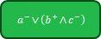
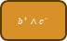
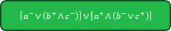
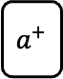





















Uniform Strategies?
$\left[a^{−}∨\left(b^{+}∧c^{−}\right)\right]∨\left[a^{+}∧\left(b^{−}∨c^{+}\right)\right]$
$a^{−}∨\left(b^{+}∧c^{−}\right)$
$a^{+}∧\left(b^{−}∨c^{+}\right)$
$a^{−}$
$b^{+}∧c^{−}$
$a^{+}$
$$b^{−}∨c^{+}$$
$b^{+}$
$c^{−}$
$b^{−}$
$c^{+}$
$\left[a^{−}∨\left(b^{+}∧c^{−}\right)\right]∨\left[a^{+}∧\left(b^{−}∨c^{+}\right)\right]$
$\left[a^{−}∨\left(b^{+}∧c^{−}\right)\right]∨\left[a^{+}∧\left(b^{−}∨c^{+}\right)\right]$
$a^{−}∨\left(b^{+}∧c^{−}\right)$
$a^{+}∧\left(b^{−}∨c^{+}\right)$
$a^{−}∨\left(b^{+}∧c^{−}\right)$
$a^{+}∧\left(b^{−}∨c^{+}\right)$
$a^{−}$
$b^{+}∧c^{−}$
$a^{+}$
$$b^{−}∨c^{+}$$
$b^{+}$
$c^{−}$
$b^{−}$
$c^{+}$
$\left[a^{−}∨\left(b^{+}∧c^{−}\right)\right]∨\left[a^{+}∧\left(b^{−}∨c^{+}\right)\right]$
$a^{−}$
$b^{+}∧c^{−}$
$a^{+}$
$$b^{−}∨c^{+}$$
$a^{−}∨\left(b^{+}∧c^{−}\right)$
$a^{+}∧\left(b^{−}∨c^{+}\right)$
$a^{−}$
$b^{+}∧c^{−}$
$a^{+}$
$$b^{−}∨c^{+}$$
$b^{+}$
$c^{−}$
$b^{−}$
$c^{+}$
$b^{+}$
$c^{−}$
$b^{−}$
$c^{+}$
$\left[a^{−}∨\left(b^{+}∧c^{−}\right)\right]∨\left[a^{+}∧\left(b^{−}∨c^{+}\right)\right]$
$a^{−}∨\left(b^{+}∧c^{−}\right)$
$a^{+}∧\left(b^{−}∨c^{+}\right)$
$a^{−}$
$b^{+}∧c^{−}$
$a^{+}$
$$b^{−}∨c^{+}$$
$b^{+}$
$c^{−}$
$b^{−}$
$c^{+}$

Slide 12














Uniform Strategies?
$\left[a^{−}∨\left(b^{+}∧c^{−}\right)\right]∨\left[a^{+}∧\left(b^{−}∨c^{+}\right)\right]$
$a^{−}∨\left(b^{+}∧c^{−}\right)$
$a^{−}$
$\left[a^{−}∨\left(b^{+}∧c^{−}\right)\right]∨\left[a^{+}∧\left(b^{−}∨c^{+}\right)\right]$
$\left[a^{−}∨\left(b^{+}∧c^{−}\right)\right]∨\left[a^{+}∧\left(b^{−}∨c^{+}\right)\right]$
$a^{−}∨\left(b^{+}∧c^{−}\right)$
$a^{−}∨\left(b^{+}∧c^{−}\right)$
$a^{+}∧\left(b^{−}∨c^{+}\right)$
$b^{+}∧c^{−}$
$b^{+}$
$c^{−}$
$\left[a^{−}∨\left(b^{+}∧c^{−}\right)\right]∨\left[a^{+}∧\left(b^{−}∨c^{+}\right)\right]$
$a^{−}$
$b^{+}∧c^{−}$
$a^{+}$
$$b^{−}∨c^{+}$$
$a^{+}∧\left(b^{−}∨c^{+}\right)$
$a^{+}$
$$b^{−}∨c^{+}$$
$b^{+}$
$c^{−}$
$b^{−}$
$c^{+}$
$b^{−}$
$\left[a^{−}∨\left(b^{+}∧c^{−}\right)\right]∨\left[a^{+}∧\left(b^{−}∨c^{+}\right)\right]$
$a^{+}∧\left(b^{−}∨c^{+}\right)$
$a^{+}$
$$b^{−}∨c^{+}$$
$c^{+}$

Slide 13




Uniform Strategies?
$\left[a^{−}∨\left(b^{+}∧c^{−}\right)\right]∨\left[a^{+}∧\left(b^{−}∨c^{+}\right)\right]$
not winning for $ℐ=\left\{a^{+},b^{+},c^{+}\right\}$
$a^{−}∨\left(b^{+}∧c^{−}\right)$
$a^{−}$
$\left[a^{−}∨\left(b^{+}∧c^{−}\right)\right]∨\left[a^{+}∧\left(b^{−}∨c^{+}\right)\right]$
$\left[a^{−}∨\left(b^{+}∧c^{−}\right)\right]∨\left[a^{+}∧\left(b^{−}∨c^{+}\right)\right]$
$a^{−}∨\left(b^{+}∧c^{−}\right)$
not winning for $ℐ=\left\{a^{+},b^{+},c^{+}\right\}$
$a^{−}∨\left(b^{+}∧c^{−}\right)$
$a^{+}∧\left(b^{−}∨c^{+}\right)$
$b^{+}∧c^{−}$
$b^{+}$
$c^{−}$
$\left[a^{−}∨\left(b^{+}∧c^{−}\right)\right]∨\left[a^{+}∧\left(b^{−}∨c^{+}\right)\right]$
$a^{−}$
$b^{+}∧c^{−}$
$a^{+}$
$$b^{−}∨c^{+}$$
$a^{+}∧\left(b^{−}∨c^{+}\right)$
not winning for $ℐ=\left\{a^{−},b^{+},c^{+}\right\}$
$a^{+}$
$$b^{−}∨c^{+}$$
$b^{+}$
$c^{−}$
$b^{−}$
$c^{+}$
$b^{−}$
$\left[a^{−}∨\left(b^{+}∧c^{−}\right)\right]∨\left[a^{+}∧\left(b^{−}∨c^{+}\right)\right]$
$a^{+}∧\left(b^{−}∨c^{+}\right)$
not winning for $ℐ=\left\{a^{−},b^{+},c^{+}\right\}$
$a^{+}$
$$b^{−}∨c^{+}$$
$c^{+}$

Slide 14



The Provability Game
Formula $F=\left[a^{−}∨\left(b^{+}∧c^{−}\right)\right]∨\left[a^{+}∧\left(b^{−}∨c^{+}\right)\right]$
$∨$
P chooses
$B$
P can create backup copies: at $F$, continue with $F∥F$
$∧$
O chooses
$a^{±}$
P wins in $a^{±}$ iff for every model $ℐ$, $ℐ⊨a^{±}$
$a^{±}$
O wins otherwise

Slide 15





The Provability Game
Formula $F=\left[a^{−}∨\left(b^{+}∧c^{−}\right)\right]∨\left[a^{+}∧\left(b^{−}∨c^{+}\right)\right]$
$∨$
P chooses
P can create backup copies: at $F_{1}∥…∥F_{i}∥…∥F_{n}$, continue with
$F_{1}∥…∥F_{i}∥F_{i}∥…∥F_{n}$
$B$
$∧$
O chooses
$Win$
P wins in $a_{1}^{±}∥…∥a_{n}^{±}$ iff for every model $ℐ$, there is some $i$ with $ℐ⊨a_{i}^{±}$
$S$
P is the scheduler
$Win$
O wins otherwise

Slide 16

Example
$\left[a^{−}∨\left(b^{+}∧c^{−}\right)\right]∨\left[a^{+}∧\left(b^{−}∨c^{+}\right)\right]$

Slide 17
Example
$\left[a^{−}∨\left(b^{+}∧c^{−}\right)\right]∨\left[a^{+}∧\left(b^{−}∨c^{+}\right)\right]$
$$\left[a^{−}∨\left(b^{+}∧c^{−}\right)\right]∨\left[a^{+}∧\left(b^{−}∨c^{+}\right)\right]∥\left[a^{−}∨\left(b^{+}∧c^{−}\right)\right]∨\left[a^{+}∧\left(b^{−}∨c^{+}\right)\right]$$

Slide 18
Example
$\left[a^{−}∨\left(b^{+}∧c^{−}\right)\right]∨\left[a^{+}∧\left(b^{−}∨c^{+}\right)\right]$
$$\underline{\left[a^{−}∨\left(b^{+}∧c^{−}\right)\right]∨\left[a^{+}∧\left(b^{−}∨c^{+}\right)\right]}∥\left[a^{−}∨\left(b^{+}∧c^{−}\right)\right]∨\left[a^{+}∧\left(b^{−}∨c^{+}\right)\right]$$
Notes:
Überschriften Größe gleich

Slide 19

Example
$\left[a^{−}∨\left(b^{+}∧c^{−}\right)\right]∨\left[a^{+}∧\left(b^{−}∨c^{+}\right)\right]$
$$\underline{\left[a^{−}∨\left(b^{+}∧c^{−}\right)\right]∨\left[a^{+}∧\left(b^{−}∨c^{+}\right)\right]}∥\left[a^{−}∨\left(b^{+}∧c^{−}\right)\right]∨\left[a^{+}∧\left(b^{−}∨c^{+}\right)\right]$$
$$a^{−}∨\left(b^{+}∧c^{−}\right)∥\left[a^{−}∨\left(b^{+}∧c^{−}\right)\right]∨\left[a^{+}∧\left(b^{−}∨c^{+}\right)\right]$$

Slide 20

Example
$\left[a^{−}∨\left(b^{+}∧c^{−}\right)\right]∨\left[a^{+}∧\left(b^{−}∨c^{+}\right)\right]$
$$\underline{\left[a^{−}∨\left(b^{+}∧c^{−}\right)\right]∨\left[a^{+}∧\left(b^{−}∨c^{+}\right)\right]}∥\left[a^{−}∨\left(b^{+}∧c^{−}\right)\right]∨\left[a^{+}∧\left(b^{−}∨c^{+}\right)\right]$$
$$a^{−}∨\left(b^{+}∧c^{−}\right)∥\underline{\left[a^{−}∨\left(b^{+}∧c^{−}\right)\right]∨\left[a^{+}∧\left(b^{−}∨c^{+}\right)\right]}$$

Slide 21

Example
$\left[a^{−}∨\left(b^{+}∧c^{−}\right)\right]∨\left[a^{+}∧\left(b^{−}∨c^{+}\right)\right]$
$$\underline{\left[a^{−}∨\left(b^{+}∧c^{−}\right)\right]∨\left[a^{+}∧\left(b^{−}∨c^{+}\right)\right]}∥\left[a^{−}∨\left(b^{+}∧c^{−}\right)\right]∨\left[a^{+}∧\left(b^{−}∨c^{+}\right)\right]$$
$$a^{−}∨\left(b^{+}∧c^{−}\right)∥\underline{\left[a^{−}∨\left(b^{+}∧c^{−}\right)\right]∨\left[a^{+}∧\left(b^{−}∨c^{+}\right)\right]}$$
$$a^{−}∨\left(b^{+}∧c^{−}\right)∥\underline{a^{+}∧\left(b^{−}∨c^{+}\right)}$$

Slide 22


Example
$\left[a^{−}∨\left(b^{+}∧c^{−}\right)\right]∨\left[a^{+}∧\left(b^{−}∨c^{+}\right)\right]$
$$\underline{\left[a^{−}∨\left(b^{+}∧c^{−}\right)\right]∨\left[a^{+}∧\left(b^{−}∨c^{+}\right)\right]}∥\left[a^{−}∨\left(b^{+}∧c^{−}\right)\right]∨\left[a^{+}∧\left(b^{−}∨c^{+}\right)\right]$$
$$a^{−}∨\left(b^{+}∧c^{−}\right)∥\underline{\left[a^{−}∨\left(b^{+}∧c^{−}\right)\right]∨\left[a^{+}∧\left(b^{−}∨c^{+}\right)\right]}$$
$$a^{−}∨\left(b^{+}∧c^{−}\right)∥\underline{a^{+}∧\left(b^{−}∨c^{+}\right)}$$
$$\underline{a^{−}∨\left(b^{+}∧c^{−}\right)}∥a^{+}$$
$$\underline{a^{−}∨\left(b^{+}∧c^{−}\right)}∥b^{−}∨c^{+}$$

Slide 23

Example
$\left[a^{−}∨\left(b^{+}∧c^{−}\right)\right]∨\left[a^{+}∧\left(b^{−}∨c^{+}\right)\right]$
$$\underline{\left[a^{−}∨\left(b^{+}∧c^{−}\right)\right]∨\left[a^{+}∧\left(b^{−}∨c^{+}\right)\right]}∥\left[a^{−}∨\left(b^{+}∧c^{−}\right)\right]∨\left[a^{+}∧\left(b^{−}∨c^{+}\right)\right]$$
$$a^{−}∨\left(b^{+}∧c^{−}\right)∥\underline{\left[a^{−}∨\left(b^{+}∧c^{−}\right)\right]∨\left[a^{+}∧\left(b^{−}∨c^{+}\right)\right]}$$
$$a^{−}∨\left(b^{+}∧c^{−}\right)∥\underline{a^{+}∧\left(b^{−}∨c^{+}\right)}$$
$$\underline{a^{−}∨\left(b^{+}∧c^{−}\right)}∥a^{+}$$
$$\underline{a^{−}∨\left(b^{+}∧c^{−}\right)}∥b^{−}∨c^{+}$$
$$a^{−}∥a^{+}$$

Slide 24

Example
$\left[a^{−}∨\left(b^{+}∧c^{−}\right)\right]∨\left[a^{+}∧\left(b^{−}∨c^{+}\right)\right]$
$$\underline{\left[a^{−}∨\left(b^{+}∧c^{−}\right)\right]∨\left[a^{+}∧\left(b^{−}∨c^{+}\right)\right]}∥\left[a^{−}∨\left(b^{+}∧c^{−}\right)\right]∨\left[a^{+}∧\left(b^{−}∨c^{+}\right)\right]$$
$$a^{−}∨\left(b^{+}∧c^{−}\right)∥\underline{\left[a^{−}∨\left(b^{+}∧c^{−}\right)\right]∨\left[a^{+}∧\left(b^{−}∨c^{+}\right)\right]}$$
$$a^{−}∨\left(b^{+}∧c^{−}\right)∥\underline{a^{+}∧\left(b^{−}∨c^{+}\right)}$$
$$\underline{a^{−}∨\left(b^{+}∧c^{−}\right)}∥a^{+}$$
$$\underline{a^{−}∨\left(b^{+}∧c^{−}\right)}∥b^{−}∨c^{+}$$
$$a^{−}∥a^{+}$$
$$\underline{b^{+}∧c^{−}}∥b^{−}∨c^{+}$$

Slide 25


Example
$\left[a^{−}∨\left(b^{+}∧c^{−}\right)\right]∨\left[a^{+}∧\left(b^{−}∨c^{+}\right)\right]$
$$\underline{\left[a^{−}∨\left(b^{+}∧c^{−}\right)\right]∨\left[a^{+}∧\left(b^{−}∨c^{+}\right)\right]}∥\left[a^{−}∨\left(b^{+}∧c^{−}\right)\right]∨\left[a^{+}∧\left(b^{−}∨c^{+}\right)\right]$$
$$a^{−}∨\left(b^{+}∧c^{−}\right)∥\underline{\left[a^{−}∨\left(b^{+}∧c^{−}\right)\right]∨\left[a^{+}∧\left(b^{−}∨c^{+}\right)\right]}$$
$$a^{−}∨\left(b^{+}∧c^{−}\right)∥\underline{a^{+}∧\left(b^{−}∨c^{+}\right)}$$
$$\underline{a^{−}∨\left(b^{+}∧c^{−}\right)}∥a^{+}$$
$$\underline{a^{−}∨\left(b^{+}∧c^{−}\right)}∥b^{−}∨c^{+}$$
$$a^{−}∥a^{+}$$
$$\underline{b^{+}∧c^{−}}∥b^{−}∨c^{+}$$
$$b^{+}∥\underline{b^{−}∨c^{+}}$$
$$c^{−}∥\underline{b^{−}∨c^{+}}$$

Slide 26

Example
$\left[a^{−}∨\left(b^{+}∧c^{−}\right)\right]∨\left[a^{+}∧\left(b^{−}∨c^{+}\right)\right]$
$$\underline{\left[a^{−}∨\left(b^{+}∧c^{−}\right)\right]∨\left[a^{+}∧\left(b^{−}∨c^{+}\right)\right]}∥\left[a^{−}∨\left(b^{+}∧c^{−}\right)\right]∨\left[a^{+}∧\left(b^{−}∨c^{+}\right)\right]$$
$$a^{−}∨\left(b^{+}∧c^{−}\right)∥\underline{\left[a^{−}∨\left(b^{+}∧c^{−}\right)\right]∨\left[a^{+}∧\left(b^{−}∨c^{+}\right)\right]}$$
$$a^{−}∨\left(b^{+}∧c^{−}\right)∥\underline{a^{+}∧\left(b^{−}∨c^{+}\right)}$$
$$\underline{a^{−}∨\left(b^{+}∧c^{−}\right)}∥a^{+}$$
$$\underline{a^{−}∨\left(b^{+}∧c^{−}\right)}∥b^{−}∨c^{+}$$
$$a^{−}∥a^{+}$$
$$\underline{b^{+}∧c^{−}}∥b^{−}∨c^{+}$$
$$b^{+}∥\underline{b^{−}∨c^{+}}$$
$$c^{−}∥\underline{b^{−}∨c^{+}}$$
$$b^{+}∥b^{−}$$

Slide 27

Example
$\left[a^{−}∨\left(b^{+}∧c^{−}\right)\right]∨\left[a^{+}∧\left(b^{−}∨c^{+}\right)\right]$
$$\underline{\left[a^{−}∨\left(b^{+}∧c^{−}\right)\right]∨\left[a^{+}∧\left(b^{−}∨c^{+}\right)\right]}∥\left[a^{−}∨\left(b^{+}∧c^{−}\right)\right]∨\left[a^{+}∧\left(b^{−}∨c^{+}\right)\right]$$
$$a^{−}∨\left(b^{+}∧c^{−}\right)∥\underline{\left[a^{−}∨\left(b^{+}∧c^{−}\right)\right]∨\left[a^{+}∧\left(b^{−}∨c^{+}\right)\right]}$$
$$a^{−}∨\left(b^{+}∧c^{−}\right)∥\underline{a^{+}∧\left(b^{−}∨c^{+}\right)}$$
$$\underline{a^{−}∨\left(b^{+}∧c^{−}\right)}∥a^{+}$$
$$\underline{a^{−}∨\left(b^{+}∧c^{−}\right)}∥b^{−}∨c^{+}$$
$$a^{−}∥a^{+}$$
$$\underline{b^{+}∧c^{−}}∥b^{−}∨c^{+}$$
$$b^{+}∥\underline{b^{−}∨c^{+}}$$
$$c^{−}∥\underline{b^{−}∨c^{+}}$$
$$b^{+}∥b^{−}$$
$$c^{−}∥c^{+}$$

Slide 28


Adequacy
P has wss in $S_{ℐ}\left(F\right)$ for all $ℐ$
P has a ws in $P\left(F\right)$

Slide 29




Adequacy
P has wss in $S_{ℐ}\left(φ\right)$ for all $ℐ$
O has a ws in $S_{ℐ}\left(φ\right)$ for some $ℐ$
extract
extract
P has a ws in $P\left(φ\right)$
O has a ws in $P\left(φ\right)$

Slide 30








Example (of a proof)
$$b^{+}∥b^{−}$$
$$c^{−}∥c^{+}$$
$$b^{+}∥\underline{b^{−}∨c^{+}}$$
$$c^{−}∥\underline{b^{−}∨c^{+}}$$
$$a^{−}∥a^{+}$$
$$\underline{b^{+}∧c^{−}}∥b^{−}∨c^{+}$$
$$\underline{a^{−}∨\left(b^{+}∧c^{−}\right)}∥a^{+}$$
$$\underline{a^{−}∨\left(b^{+}∧c^{−}\right)}∥b^{−}∨c^{+}$$
$$a^{−}∨\left(b^{+}∧c^{−}\right)∥\underline{a^{+}∧\left(b^{−}∨c^{+}\right)}$$
$$a^{−}∨\left(b^{+}∧c^{−}\right)∥\underline{\left[a^{−}∨\left(b^{+}∧c^{−}\right)\right]∨\left[a^{+}∧\left(b^{−}∨c^{+}\right)\right]}$$
$$\underline{\left[a^{−}∨\left(b^{+}∧c^{−}\right)\right]∨\left[a^{+}∧\left(b^{−}∨c^{+}\right)\right]}∥\left[a^{−}∨\left(b^{+}∧c^{−}\right)\right]∨\left[a^{+}∧\left(b^{−}∨c^{+}\right)\right]$$
$$\left[a^{−}∨\left(b^{+}∧c^{−}\right)\right]∨\left[a^{+}∧\left(b^{−}∨c^{+}\right)\right]$$

Slide 31


From Provability Games to Proofs
Notes:
Example schaut rüber

Slide 32














Proof Theory
$∨$
$∧$
$B$
$Win$
at $F_{1}∨F_{2}$, P chooses between $F_{1}$ and $F_{2}$
at $F_{1}∧F_{2}$, O chooses between $F_{1}$ and $F_{2}$
P can create backup copies: at $𝒟∥F$, continue with
$𝒟∥F∥F$
P wins in $a_{1}^{±}∥…∥a_{n}^{±}∥b^{+}∥b^{−}$
$$\frac{𝒟∥F_{1}}{𝒟∥F_{1}∨F_{2}}{\left(∨\right)}_{1}$$
$$\frac{\begin{matrix}𝒟∥F_{1} & 𝒟∥F_{2}\end{matrix}}{𝒟∥F_{1}∧F_{2}}\left(∧\right)$$
$$\frac{𝒟∥F∥F}{𝒟∥F}\left(c\right)$$
$a_{1}^{±}∥…∥a_{n}^{±}∥b^{+}∥b^{−}$ (Axiom)
$$\frac{𝒟∥F_{2}}{𝒟∥F_{1}∨F_{2}}{\left(∨\right)}_{2}$$
There is a proof of $F$ iff $F$ is valid in CL.
Notes:
Start: 15min.

Slide 33
What‘s more.
Semantic Game (truth in a model)
Negation
Regulations
lift
Provability Game
(validity)
extract
Analytic Calculus

Slide 34
Outline
✅ Games, Strategies, and the Lifting Technique
🔜 Games in Logic
🔜 Games for Modal Logics (Chapter 3)
🔜 Games for Choice Logics (Chapter 4)
🔜 A General Framework (Chapter 5)

Slide 35



Games in Logic
Semantic Games (Evaluation Games)
Played over formula $F$ and model $ℳ$
Played over formula 𝐹 and model ℳ
Hintikka‘s
H‘s-style game for Modal Logic
Giles‘s
truth-degree comparison
Adequacy: P has a ws iff $ℳ⊨F$
Adequacy: P has a ws iff ℳ⊨𝐹
Provability Games (Dialogue Games)
Played over formula $F$
📕 📗
LIFTING
Lorenzen‘s
Mezhirov‘s
every proof system 🙄
Adequacy: P has a ws iff $⊨F$
Other games:
model construction games
bisimulation games
Logic in Games
…
📕 Chris Fermüller and George Metcalfe. Giles’s Game and the Proof Theory of Łukasiewicz Logic. Studia Logica. 2009.
📗 Agata Ciabattoni, Chris Fermüller, and George Metcalfe. Uniform Rules and Dialogue Games for Fuzzy Logics. LPAR. 2005.
Notes:
5min for this part

Slide 36








Modal Logics
$v$
$$a^{+},b^{+}$$
$w$
$$a^{+},b^{−}$$
$u$
$$a^{−},b^{−}$$
$□F$ … $F$ is…
… necessary
… known
… obligatory
…
📷Annie Spratt
Notes:
bis hier: 22:40.
Betonen: zentraler eigenständiger Beitrag zur Diss

Slide 37

















Semantic Game
$v$
$$a^{+},b^{+}$$
$w$
$$a^{+},b^{−}$$
$u$
Formula $F=◇(a^{+}∧b^{−})$ + model + world
$$a^{−},b^{−}$$
$◇$
at $w:◇F$, P chooses an $wRv$ to continue with $v:F$
$$w:◇(a^{+}∧b^{−})$$
$□$
at $w:□F$,
O chooses an $wRv$ to continue with $v:F$
$$w:a^{+}∧b^{−}$$
$$v:a^{+}∧b^{−}$$
$∨$
P chooses
$w:a^{−}$
$w:b^{−}$
$v:a^{−}$
$v:b^{−}$
$∧$
O chooses
$w:a^{±}$
P wins iff $ℳ,w⊨a^{±}$
$w:a^{±}$
O wins iff $ℳ,w⊭a^{±}$

Slide 38
Semantic Game
$v$
$$a^{+},b^{+}$$
$w$
$$a^{+},b^{−}$$
$u$
Formula $F=◇(a^{+}∧b^{−})$ + model + world
$$a^{−},b^{−}$$
$◇$
at $w:◇F$, P chooses an $wRv$ to continue with $v:F$
$$w:◇(a^{+}∧b^{−})$$
$□$
at $w:□F$,
O chooses an $wRv$ to continue with $v:F$
$$v:a^{+}∧b^{−}$$
$∨$
P chooses
$v:a^{−}$
$v:b^{−}$
$∧$
O chooses
$w:a^{±}$
P wins iff $ℳ,w⊨a^{±}$
$w:a^{±}$
O wins iff $ℳ,w⊭a^{±}$

Slide 39













Hybrid Logics
$$Nom$$
$$i$$
$$g$$
$v$
$$a^{+},b^{+}$$
$$j$$
$w$
$$a^{+},b^{−}$$
$u$
$$k$$
$$a^{−},b^{−}$$
$ℳ,w⊨R^{+}\left(i,j\right)$ iff $g\left(i\right)→g\left(j\right)$
$ℳ,w⊨R^{−}\left(i,j\right)$ iff $g\left(i\right)↛g\left(j\right)$
Consider named models, i.e. $g$ surjective.
📕 Patrick Blackburn, Maarten de Rijke, and Yde Venema. Modal Logic. 2001.
Notes:
w curly nein!
Abstand zwischen Buch und Name, auch auf anderen Slides.
i.e.,

Slide 40




Hybrid Logics
$$j$$
$$a^{+},b^{+}$$
$$a^{+},b^{−}$$
$$i$$
$$k$$
$$a^{−},b^{−}$$
$ℳ,w⊨R^{+}\left(i,j\right)$ iff $g\left(i\right)→g\left(j\right)$
$ℳ,w⊨R^{−}\left(i,j\right)$ iff $g\left(i\right)↛g\left(j\right)$
Consider only named models, i.e., $g$ surjective.
📕 Patrick Blackburn, Maarten de Rijke, and Yde Venema. Modal Logic. 2001.

Slide 41






























Semantic Game
$$j$$
$$a^{+},b^{+}$$
$$a^{+},b^{−}$$
$$i$$
$$k$$
$$a^{−},b^{−}$$
Formula $F=◇(a^{+}∧b^{−})$ + model + nominal
$◇$
at $i:◇F$, P chooses an $i$
to continue with $j:R^{+}\left(i,i\right)∧F$
$$i:◇(a^{+}∧b^{−})$$
$□$
at $i:□F$, O chooses an $i$
to continue with $j:R^{−}\left(i,i\right)∨F$
$$i:R^{+}\left(i,i\right)∧\left(a^{+}∧b^{−}\right)$$
$$j:R^{+}\left(i,i\right)∧\left(a^{+}∧b^{−}\right)$$
$$…$$
$$k:R^{+}\left(i,k\right)∧\left(a^{+}∧b^{−}\right)$$
$∨$
P chooses
$$R^{+}\left(i,i\right)$$
$$i:a^{+}∧b^{−}$$
$$R^{+}\left(i,j\right)$$
$$j:a^{+}∧b^{−}$$
$$R^{+}\left(i,j\right)$$
$$k:a^{+}∧b^{−}$$
$∧$
O chooses
$$i:a^{+}$$
$$i:b^{−}$$
$$j:a^{+}$$
$$j:b^{−}$$
$$k:a^{+}$$
$$k:b^{−}$$
$i:a^{±}$
P wins iff $ℳ,g(i)⊨a^{±}$
$i:a^{±}$
O wins iff $ℳ,g(i)⊭a^{±}$
P has a ws in $S_{ℳ}^{H}\left(i:F\right)$ iff $ℳ,g\left(i\right)⊨F$.

Slide 42














Proof Theory
$$\frac{𝒟∥i:F_{1}}{𝒟∥i:F_{1}∨F_{2}}{\left(∨\right)}_{1}$$
$$\frac{\begin{matrix}𝒟∥i:F_{1} & 𝒟∥i:F_{2}\end{matrix}}{𝒟∥i:F_{1}∧F_{2}}\left(∧\right)$$
$$\frac{𝒟∥i:F∥i:F}{𝒟∥i:F}\left(c\right)$$
$a_{1}^{±}∥…∥a_{n}^{±}$ (Axiom)
… winning*
$$\frac{𝒟∥i:F_{2}}{𝒟∥i:F_{1}∨F_{2}}{\left(∨\right)}_{2}$$
$$\frac{𝒟∥j:R^{+}\left(i,j\right)∧G}{𝒟∥i:◇G}\left(◇\right)$$
$$\frac{𝒟∥j:R^{−}\left(i,j\right)∨G}{𝒟∥i:□G}\left(□\right)$$
… $j$ is not in $𝒟, G$
*P-time checkable
$◇$
$□$
There is a proof of $i:F$ iff* $F$ is valid in $H$.
at $i:◇F$,
P chooses a j to continue with $j:R^{+}\left(i,j\right)∧F$
at $i:□F$,
O chooses a j to continue with $j:R^{−}\left(i,j\right)∨F$
*$i$ does not appear in $F$
📕 Torben Braüner. Hybrid Logic and its Proof-Theory. 2010.

Slide 43



Summing up…
Uniformity of game trees is a necessary condition for lifting
Go to hybrid logic
Other connectives: $∀i$, $@_{i}$, …
Local/global entailment
Provability for classes of frames: $∀i.R^{−}\left(i,i\right)$
Instantiation to specific context (PNL)
Fixed points lead to circular proof systems
📘 RF. Games for Hybrid Logic. WoLLIC 2021
📕 RF. Games for Hybrid Logic. Journal of Logic and Computation, (to appear).
Notes:
9:30

Slide 44





Choice Logics
$$apricot∧\left(banana\overset{⃑}{∨}chocolate\right)$$
$ℐ_{1}=\left\{a\right\}$
$$ℐ_{2}=\left\{a,b\right\}$$
$$ℐ_{3}=\left\{a,c\right\}$$
📕 Gerhard Brewka, Salem Benferhat, and Daniel Le Berre. Qualitative choice logic. 2004.
Notes:
31:02, vielleicht +1-2min.

Slide 45














Capturing preferences
$∨$
$$F_{1}\overset{⃑}{∨}F_{2}$$
P chooses
$\overset{⃑}{∨}$
$∧$
$$F_{1}$$
$$F_{2}$$
O chooses
At $F_{1}\overset{⃑}{∨}F_{2}$, P chooses between $F_{1}$ and $F_{2}$
but prefers $F_{1}$
$a^{±}$
P wins iff $ℐ⊨p^{±}$
$$a_{1}^{±}$$
$$a_{2}^{±}$$
$$a_{1}^{±}$$
$$a_{2}^{±}$$
$a^{±}$
O wins iff $ℐ⊭a^{±}$

Slide 46



Capturing preferences
$∨$
$$F_{1}\overset{⃑}{∨}F_{2}$$
P chooses
$\overset{⃑}{∨}$
$∧$
$$F_{1}$$
$$F_{2}$$
O chooses
At $F_{1}\overset{⃑}{∨}F_{2}$, P chooses between $F_{1}$ and $F_{2}$
but prefers $F_{1}$
$a^{±}$
P wins iff $ℐ⊨p^{±}$
$$a_{1}^{±}$$
$$a_{2}^{±}$$
$a^{±}$
O wins iff $ℐ⊭a^{±}$
$$a_{1}^{±}$$
$$≫$$
$$a_{2}^{±}$$

Slide 47



Capturing preferences
$∨$
P chooses
$\overset{⃑}{∨}$
$\overset{⃑}{∧}$
$∧$
O chooses
At $F_{1}\overset{⃑}{∨}F_{2}$, P chooses between $F_{1}$ and $F_{2}$
but prefers $F_{1}$
At $F_{1}\overset{⃑}{∧}F_{2}$, O chooses between $F_{1}$ and $F_{2}$
but prefers $F_{1}$
$a^{±}$
P wins iff $ℐ⊨p^{±}$
$a^{±}$
O wins iff $ℐ⊭a^{±}$

Slide 48




















Capturing Preferences
$∨$
P chooses
$$\left(a^{+}\overset{⃑}{∨} \left(b^{+}\overset{⃑}{∨} c^{+}\right)\right)∨\left(a^{−}\overset{⃑}{∧} c^{−}\right)$$
$∧$
O chooses
$$a^{+}\overset{⃑}{∨}\left(b^{+}\overset{⃑}{∨}c^{+}\right)$$
$$a^{−}\overset{⃑}{∧}c^{−}$$
$\overset{⃑}{∨}$
P chooses prefers left
$a^{+}$
$$b^{+}\overset{⃑}{∨}c^{+}$$
$a^{−}$
$c^{−}$
$$≫$$
$\overset{⃑}{∧}$
O chooses prefers left
$$≫$$
$b^{+}$
$$≫$$
$c^{+}$
$a^{±}$
P wins iff $ℐ⊨p^{±}$
$a^{±}$
O wins iff $ℐ⊭a^{±}$

Slide 49















Payoff = Winning + Preferences
$c^{+}$
$b^{+}$
$a^{+}$
$a^{−}$
$c^{−}$
$$a^{+}$$
$$b^{+}$$
$$c^{+}$$
$$≫$$
$$≫$$
$$≫$$
$$⋮$$
$$a^{−}$$
$$b^{−}$$
$$c^{−}$$

Slide 50


Payoff = Winning + Preferences
$b^{+}$
$$a^{+}$$
$$b^{+}$$
$$c^{+}$$
$c^{+}$
$b^{+}$
$c^{+}$
$a^{+}$
$a^{+}$
$a^{−}$
$a^{−}$
$c^{−}$
$$≫$$
$c^{−}$
$$≫$$
$$≫$$
$$≫$$
$$≫$$
$$≫$$
$$⋮$$
$$a^{−}$$
$$b^{−}$$
$$c^{−}$$
O wins
P wins

Slide 51





Payoff = Winning + Preferences
$c^{+}$
$b^{+}$
$a^{+}$
$a^{−}$
$c^{−}$
$$a^{+}$$
$$b^{+}$$
$$c^{+}$$
$$≫$$
$$≫$$
$$≫$$
$$⋮$$
$$a^{−}$$
$$b^{−}$$
$$c^{−}$$
$a^{−}$
$a^{+}$
$c^{+}$
$c^{−}$
$b^{+}$
O wins
P wins

Slide 52






Payoff = Winning + Preferences
$b^{+}$
$$a^{+}$$
$$b^{+}$$
$$c^{+}$$
$c^{+}$
$b^{+}$
$a^{+}$
$a^{−}$
$c^{−}$
$c^{+}$
$$≫$$
$$≫$$
$a^{+}$
$a^{−}$
$$≫$$
$c^{−}$
$$≫$$
$$≫$$
$$≫$$
$$≫$$
$$≫$$
$$≫$$
$$⋮$$
$$a^{−}$$
$$b^{−}$$
$$c^{−}$$
$a^{−}$
$a^{+}$
$c^{+}$
$c^{−}$
$b^{+}$
O wins
P wins

Slide 53






















Payoff = Winning + Preferences
$c^{+}$
$b^{+}$
$a^{+}$
$a^{−}$
$c^{−}$
$$a^{+}$$
$$b^{+}$$
$$c^{+}$$
$$≫$$
$$≫$$
$a^{−}$
$$≫$$
$c^{−}$
$$≫$$
$$⋮$$
$$a^{−}$$
$$b^{−}$$
$$c^{−}$$
$$δ_{ℐ}\left(d^{±}\right)=\left\{\begin{matrix}−π_{≪}(d^{±}) & \text{if} ℐ⊨d^{±} \\ −π_{≫}(d^{±}) & \text{if} ℐ⊭d^{±}\end{matrix}\right.$$
$$π_{≪}=2$$
$a^{−}$
$$≫$$
$c^{−}$
$$π_{≫}=3$$
$c^{+}$
$$≫$$
$b^{+}$
$$≫$$
$a^{+}$
$c^{+}$
$$≫$$
$b^{+}$
$$≫$$
$a^{+}$
$$−1$$
$$−2$$
$$−3$$
$$3$$
$$2$$
$$1$$
O wins
P wins

Slide 54

















Example
$$a^{+}$$
$$b^{+}$$
$$c^{+}$$
$$⋮$$
$$a^{−}$$
$$b^{−}$$
$$c^{−}$$
$∨$
P chooses
$$\left(a^{+}\overset{⃑}{∨} \left(b^{+}\overset{⃑}{∨} c^{+}\right)\right)∨\left(a^{−}\overset{⃑}{∧} c^{−}\right)$$
$∧$
O chooses
$$a^{+}\overset{⃑}{∨}\left(b^{+}\overset{⃑}{∨}c^{+}\right)$$
$$a^{−}\overset{⃑}{∧}c^{−}$$
$\overset{⃑}{∨}$
P chooses prefers left
$a^{+}$
$$b^{+}\overset{⃑}{∨}c^{+}$$
$a^{−}$
$c^{−}$
$$≫$$
$\overset{⃑}{∧}$
O chooses prefers left
$$−3$$
$$≫$$
$$2$$
$$1$$
$b^{+}$
$$≫$$
$c^{+}$
$a^{±}$
P wins iff $ℐ⊨p^{±}$
$$2$$
$$−1$$
$a^{±}$
O wins iff $ℐ⊭a^{±}$

Slide 55


Example
$$a^{+}$$
$$b^{+}$$
$$c^{+}$$
$$ℐ=$$
$$⋮$$
$$a^{−}$$
$$b^{−}$$
$$c^{−}$$
$∨$
P has a 2-strategy:
P chooses
$$\left(a^{+}\overset{⃑}{∨} \left(b^{+}\overset{⃑}{∨} c^{+}\right)\right)∨\left(a^{−}\overset{⃑}{∧} c^{−}\right)$$
$∧$
O chooses
$$a^{−}\overset{⃑}{∧}c^{−}$$
$\overset{⃑}{∨}$
P chooses prefers left
$a^{−}$
$c^{−}$
$$≫$$
$\overset{⃑}{∧}$
O chooses prefers left
$$2$$
$$1$$
$a^{±}$
Value of this game is $v_{ℐ}\left(F\right)=2$
P wins iff $ℐ⊨p^{±}$
$a^{±}$
O wins iff $ℐ⊭a^{±}$

Slide 56

Degrees of Truth and Validity
 | CL | GCL
truth | $$v_{ℐ}\left(F\right)∈\left\{−1,1\right\}$$ | $$v_{ℐ}\left(F\right)∈\left\{−1,−2,…,2,1\right\}$$
validity | $$v\left(F\right)=\min_{ℐ}{v_{ℐ}\left(F\right)}$$ | $$v_{ℐ}\left(F\right)=\min_{ℐ}{v_{ℐ}\left(F\right)}$$
How to capture the degree of validity in GCL?

Slide 57
The Provability Game for CL
$∨$
P chooses
P can create backup copies: at $F_{1}∥…∥F_{i}∥…∥F_{n}$, continue with
$F_{1}∥…∥F_{i}∥F_{i}∥…∥F_{n}$
$B$
$∧$
O chooses
$Win$
P wins in $a_{1}^{±}∥…∥a_{n}^{±}$ iff for every model $ℐ$, there is some $i$ with $ℐ⊨a_{i}^{±}$
$S$
P is the scheduler
$Win$
O wins otherwise

Slide 58




The Provability Game for CL
$∨$
P chooses
P can create backup copies: at $F_{1}∥…∥F_{i}∥…∥F_{n}$, continue with
$F_{1}∥…∥F_{i}∥F_{i}∥…∥F_{n}$
$B$
$∧$
O chooses
$Payoff$
at $𝒟=a_{1}^{±}∥…∥a_{n}^{±}$,
P receives the payoff
$$v\left(𝒟\right)=\min_{ℐ}{\max_{i=1,…,n}{v_{ℐ}\left(a_{i}^{±}\right)}}$$
$S$
P is the scheduler

Slide 59






The Provability Game for GCL
$∨$
P chooses
$B$
P can create backup copies: at $F_{1}∥…∥F_{i}∥…∥F_{n}$, continue with
$F_{1}∥…∥F_{i}∥F_{i}∥…∥F_{n}$
$∧$
O chooses
$\overset{⃑}{∨}$
$S$
P chooses prefers left
P is the scheduler
$\overset{⃑}{∧}$
O chooses prefers left
P has a $k$-strategy in $P^{GCL}\left(F\right)$ iff $v\left(F\right)⊵k$.
A $v\left(F\right)$-strategy for P is called optimal.
$Payoff$
at $𝒟=a_{1}^{±}∥…∥a_{n}^{±}$,
P receives the payoff
$$v\left(𝒟\right)=\min_{ℐ}{\max_{i=1,…,n}{v_{ℐ}\left(a_{i}^{±}\right)}}$$

Slide 60










Proof Theory
$$\frac{𝒟∥F_{1}}{𝒟∥F_{1}∨F_{2}}{\left(∨\right)}_{1}$$
$$\frac{𝒟∥F_{2}}{𝒟∥F_{1}∨F_{2}}{\left(∨\right)}_{2}$$
$$\frac{\begin{matrix}𝒟∥F_{1} & 𝒟∥F_{2}\end{matrix}}{𝒟∥F_{1}∧F_{2}}\left(∧\right)$$
$$\frac{𝒟∥F_{1}}{𝒟∥F_{1}\overset{⃑}{∨}F_{2}}{\left(\overset{⃑}{∨}\right)}_{1}$$
$$\frac{𝒟∥F_{2}}{𝒟∥F_{1}\overset{⃑}{∨}F_{2}}{\left(\overset{⃑}{∨}\right)}_{2}$$
$$\frac{\begin{matrix}𝒟∥F_{1} & 𝒟∥F_{2}\end{matrix}}{𝒟∥F_{1}\overset{⃑}{∧}F_{2}}\left(\overset{⃑}{∧}\right)$$
$a_{1}^{±}∥…∥a_{n}^{±}$ (initial sequent)
$$\frac{𝒟∥F∥F}{𝒟∥F}\left(c\right)$$
value:
$$\min_{ℐ}{\max_{i=1,…,n}{δ_{ℐ}\left(a_{i}^{±}\right)}}$$
A proof is a $k$-proof iff all initial sequents have value $⊵k$.
There is a $k$-proof of $F$ iff $v\left(F\right)⊵k$.

Slide 61












Proof Theory
$$\frac{𝒟∥{}_{l}^{k}{F_{1}}}{𝒟∥{}_{l}^{k}{{(F}_{1}∨F_{2})}}{\left(∨\right)}_{1}$$
$$\frac{𝒟∥{}_{l}^{k}{F_{2}}}{𝒟∥{}_{l}^{k}{{(F}_{1}∨F_{2})}}{\left(∨\right)}_{2}$$
$$\frac{\begin{matrix}𝒟∥{}_{l}^{k}{F_{1}} & 𝒟∥{}_{l}^{k}{F_{2}}\end{matrix}}{𝒟∥{}_{l}^{k}{{(F}_{1}∧F_{2})}}\left(∧\right)$$
$$\frac{𝒟∥{}_{l}^{k+opt\left(F_{2}\right)}{F_{1}}}{𝒟∥{}_{l}^{k}{{(F}_{1}\overset{⃑}{∨}F_{2})}}{\left(\overset{⃑}{∨}\right)}_{1}$$
$$\frac{𝒟∥{}_{l+opt\left(F_{1}\right)}^{k}{F_{2}}}{𝒟∥{}_{l}^{k}{{(F}_{1}\overset{⃑}{∨}F_{2})}}{\left(\overset{⃑}{∨}\right)}_{2}$$
$$\frac{\begin{matrix}𝒟∥{}_{l}^{k+opt\left(F_{2}\right)}{F_{1}} & 𝒟∥{}_{l+opt\left(F_{1}\right)}^{k}{F_{2}}\end{matrix}}{𝒟∥{}_{l}^{k}{{(F}_{1}\overset{⃑}{∧}F_{2})}}\left(\overset{⃑}{∧}\right)$$
${}_{l_{1}}^{k_{1}}{a_{1}^{±}}∥…∥{}_{l_{n}}^{k_{n}}{a_{n}^{±}}$ (initial sequent)
$$\frac{𝒟∥{}_{l}^{k}F∥{}_{l}^{k}F}{𝒟∥{}_{l}^{k}F}\left(c\right)$$
$$\min_{ℐ}{\max_{i=1,…,n}\left\{\begin{matrix}l_{i} & if ℐ⊨a_{i}^{±} \\ −k_{i} & if ℐ⊭a_{i}^{±}\end{matrix}\right\}}$$
value:
$$opt\left(F\right)≔\text{longest}≫\text{−}\text{path} \text{in} F\text{−}\text{game}$$
A proof is a $k$-proof iff all initial sequents have value $⊵k$.
There is a $k$-proof of $F$ iff $v\left(F\right)⊵k$.
Notes:
Proof of 11F

Slide 62
Summing up…
Preferences can be encoded as payoffs of the semantic game.
New game solves issues with negation
Degree-semantics for GCL
Game for QCL as fragment of our game
Optimal strategies correspond to contraction-free calculus
Preferred model extraction
Preferred model entailment
Non zero-sum games, ≥2 players
Non-linear order of preferences
Preferences in context: deontic logic, ”political capital” in PNL
📙 RF and Michael Bernreiter. Truth and Preferences - A Game Approach for Qualitative Choice Logic. JELIA 2023.
📗 RF and Michael Bernreiter. Validity in Choice Logics. WoLLIC 2023.
Notes:
10min

Slide 63

General Framework
Definition of abstract semantic game.
Abstract lifting.
Identify necessary criteria for success.
📷Annie Spratt
Notes:
Wichtig für den Vortrag: verstehen, dass das drinsteht, etc.
GESAMT: Schlussfolie

Slide 64
Summing up…
General definitions of semantic game, provability game and lifting
Identified criteria for successful lifting.
Criteria for regulations
Finite game are always liftable and regulation-independent.
Reducing infinite branching
Infinite semantic games and cyclic proofs
Capturing the formula-structure
≥2 players

Slide 65



Semantic Game (truth in a model)
Hybrid Logic
📘 RF. Games for Hybrid Logic. WoLLIC 2021
📕 RF. Games for Hybrid Logic. Journal of Logic and Computation, (to appear).
lift
Provability Game
(validity)
Choice Logics
📙 RF and Michael Bernreiter. Truth and Preferences - A Game Approach for Qualitative Choice Logic. JELIA 2023.
📗 RF and Michael Bernreiter. Validity in Choice Logics. WoLLIC 2023.
extract
Analytic Calculus
General Framework
Notes:
5min

Slide 66
Backup Slides

Slide 67

Problem with negation
$banana\overset{⃑}{×}chocolate$
$ℐ=\left\{c\right\}$
📷Lama Roscu

Slide 68

Problem with negation
$banana\overset{⃑}{×}chocolate$
$¬\left(banana\overset{⃑}{×}chocolate\right)$
$ℐ=\left\{c\right\}$
📷Lama Roscu

Slide 69

Problem with negation
$banana\overset{⃑}{×}chocolate$
$¬\left(banana\overset{⃑}{×}chocolate\right)$
$¬¬\left(banana\overset{⃑}{×}chocolate\right)$
$ℐ=\left\{c\right\}$
📷Lama Roscu

Slide 70

Negation in Choice Logics
 | QCL | PQCL | GCL
degree of $¬F$ depends only on the degree of $F$ | ✅ |  | ✅
$F∨¬F$ valid | ✅ | ✅ | ✅
$F∧¬F$ unsat | ✅ |  | ✅
$F$ has same degree as $¬¬F$ |  | ✅ | ✅
De Morgan's laws | ✅ | ✅ | ✅
degree semantics | ✅ | ✅ | ✅
game semantics | ✅(via GCL) |  | ✅
PROPOSITION
If $\deg_{ℐ}^{G}\left(F\right)∈ℤ^{+}$, and no $\overset{⃑}{×}$ occurs in the scope of a negation, then $\deg_{ℐ}^{G}\left(F\right)=\deg_{ℐ}\left(F\right)$.
Notes:
Complexity?

Slide 71










New degree-semantics
$${opt}^{G}\left(a\right)=1 \\ {opt}^{G}\left(¬F\right)={opt}^{G}\left(F\right) \\ {opt}^{G}\left(F∧G\right)=\min\left\{{opt}^{G}\left(F\right),{opt}^{G}\left(G\right)\right\} \\ {opt}^{G}\left(F∨G\right)=\max\left\{{opt}^{G}\left(F\right),{opt}^{G}\left(G\right)\right\} \\ {opt}^{G}\left(F\overset{⃑}{×}G\right)={opt}^{G}\left(F\right)+{opt}^{G}\left(G\right) \\ \deg_{ℐ}^{G}\left(a\right)=\left\{\begin{matrix}1 & if a∈ℐ, \\ −1 & if a∉ℐ.\end{matrix}\right. \\ \deg_{ℐ}^{G}\left(¬F\right)=−\deg_{ℐ}^{G}(F) \\ \deg_{ℐ}^{G}\left(F∧G\right)=\min\left\{\deg_{ℐ}^{G}\left(F\right),\deg_{ℐ}^{G}\left(G\right)\right\} \\ \deg_{ℐ}^{G}\left(F∨G\right)=\max\left\{\deg_{ℐ}^{G}\left(F\right),\deg_{ℐ}^{G}\left(G\right)\right\} \\ \deg_{ℐ}^{G}\left(F\overset{⃑}{×}G\right)=\left\{\begin{matrix}\deg_{ℐ}^{G}\left(F\right) & if \deg_{ℐ}^{G}\left(F\right)∈ℤ^{+}, \\ {opt}^{G}\left(F\right)+\deg_{ℐ}^{G}\left(G\right) & if \deg_{ℐ}^{G}\left(F\right)∈ℤ^{−} \text{and} \deg_{ℐ}^{G}\left(G\right)∈ℤ^{+}, \\ \deg_{ℐ}^{G}\left(F\right)−{opt}^{G}\left(G\right) & else. \end{matrix}\right.$$
false
true
$$−1$$
$$−2$$
$$−3$$
$$¬F$$
$$F$$
$$3$$
$$2$$
$$1$$
Theorem
The value of the game $S\left(F,ℐ\right)$ is $\deg_{ℐ}^{G}\left(F\right)$.

Slide 72

Semantic Games
A semantic game $S$ is a tuple $\left(Stat,Hist,Ter,𝒫\right)$, where
$Hist$ is a forest (set of P/O-labeled trees) with set of roots $Stat$ and $Ter=\text{leaves}$
$𝒫$ is a set of payoff functions $𝓅:Ter→Z$. $\left(Z,⊴\right)$ is a linear order with least element $−1$.
$S_{𝓅}\left(g\right)$ … game determined by $g∈Stat$, $𝓅∈𝒫$.

Slide 73







Semantic Game $$S=\left(Stat,Hist,Ter,𝒫\right)$$
$$g$$
$$Stat$$
$$…$$
…
$$Ter$$
$$𝓅∈𝒫$$ payoff-function
$$−1$$
$\left(Z,⊴\right)$ linear order

Slide 74

Semantic Game $$S_{𝓅}\left(g\right)$$
$$g$$
$$…$$
$$𝓅∈𝒫$$ payoff-function
$$−1$$
$\left(Z,⊴\right)$ linear order

Slide 75







Provability Game
P
P chooses
P can create backup copies: at $g_{1}∥…∥g_{i}∥…∥g_{n}$, continue with
$g_{1}∥…∥g_{i}∥g_{i}∥…∥g_{n}$
$B$
O
O chooses
at $a_{1}∥…∥a_{n},$ P receives a payoff of
$$\min_{𝓅∈𝒫}{\max_{i=1,…,n}{𝓅\left(a_{i}\right)}}$$
$S$
$Payoff$
P is the scheduler
$D⊆Hist$ is compact if it has a finite base $B$ (every $h∈D$ is an extension of some $h^{′}∈B$).
$S$ is complete iff for every compact $D⊆Ter$ every $P⊆\bigcup_{𝓅∈𝒫}{\left\{𝓅\left(h\right):h∈D\right\}}$ has a minimum and a maximum.
If $S$ is complete, then: P has a ws in $P\left(g\right)$
iff
she has a ws in $S_{𝓅}\left(g\right)$ for all $𝓅∈𝒫$.

Slide 76

Semantic Game
Def. A semantic game is a tuple $S=\left(Stat,Hist,ℓ ,𝒫\right)$, where
$Stat$ is a set of game states.
$Hist⊆Stat^{ω}$ is a set of histories over $Stat$ (poset ordered by $⊑$ (“is-initial-segment of”) and containing $\left\{\left\langle g\right\rangle :g∈Stat\right\}$).
$ℓ:\left(Hist∖Ter\right)→\left\{P,O\right\}$ is a labeling function.
$𝒫$ is a set of payoff functions $𝓅:Ter→Z$. $\left(Z,⊴\right)$ is a linear order with least element $−1$.
$D⊆Hist$ is compact if it has a finite base $B$ (every $h∈D$ is an extension of some $h^{′}∈B$).
$S$ is complete iff for every compact $D⊆Ter$ every $P⊆\bigcup_{𝓅∈𝒫}{\left\{𝓅\left(h\right):h∈D\right\}}$ has a minimum and a maximum.

Slide 77
References
Wilfrid Hodges and Jouko Väänänen. Logic and Games. SEP. 2019.
Michael Maschler, Eilon Solan, and Shmuel Zamir. Game Theory. 2013.
Johan van Benthem. Logic in Games. 2014.
Gabriella Pigozzi, Alexis Tsoukiàs, and Paolo Viappiani. Preferences in artificial intelligence. 2016.
Notes:
Falsche References, ganz nach hinten
Stattdessen: Gesamtschlussfolie mit allen DISS-Papers. (Chapters von der Thesis)

